Slide 1

Training Infrastructure for Foundation Models
CS598 FLA
Nishi Uppuluri, Akhil Sundaram, Adit Agarwal, Rohith Kattamuri
February 14th, 2025

Slide 2

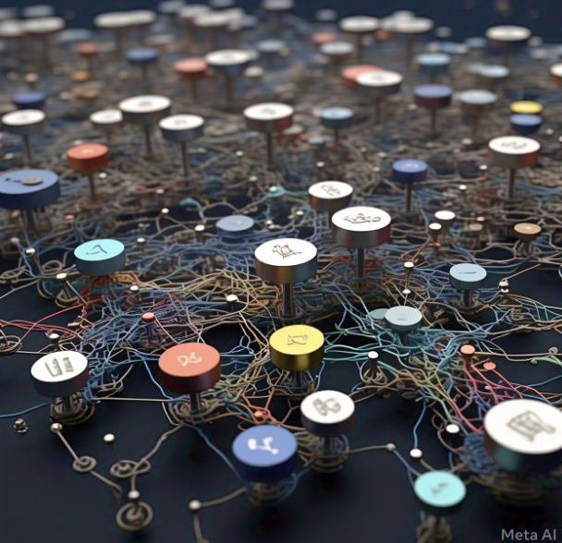
Foundation Models
"Any model that is trained on broad data (generally using self-supervision at scale) that can be adapted (e.g., fine-tuned) to a wide range of downstream tasks"
Foundational Models According to Llama-3!
COMPUTER SCIENCE
GRAINGER ENGINEERING
Notes:
Akhil:
What is a foundation model -
We asked LLama-3 to generate an image for it, and this is what it gave us.
It technically does not have any fixed definition but according to stanford - READ ABOVE.

Slide 3
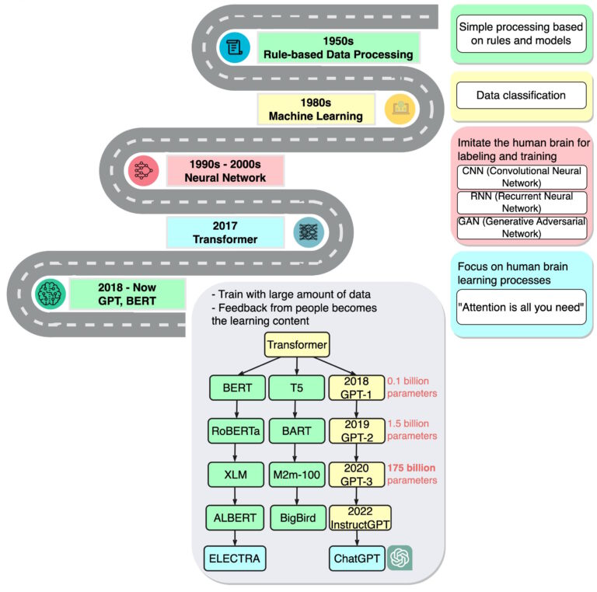
Foundation Models
Transformers (2017)
BERT (2018)
GPT-3 (2020)
Stable Diffusion (2022)
…
llama 3
Deepseek
COMPUTER SCIENCE
GRAINGER ENGINEERING
Notes:
Akhil:
Usually it means something that is very large model, but is also generally opensource.
It’s just a buzzword.
BUT it started with transformers in 2017.
THEN, google released BERT in 2018
ANd the rest just followed after that.
Today we talk about two of those - LLAMA 3, released by meta. And Deepseek-V3

Slide 4
Agenda
Llama-3 & DeepSeek
Overview
Pre-Training
Model Architecture
Infrastructure
Post-Training
COMPUTER SCIENCE
GRAINGER ENGINEERING
Notes:
Nishi:
We are going to look at the technical report for both LLAMA-3 and Deepseek-v3
Overview
Pre-Training and Post-Training
Model Architecture
Infrastructure and scaling

Slide 5


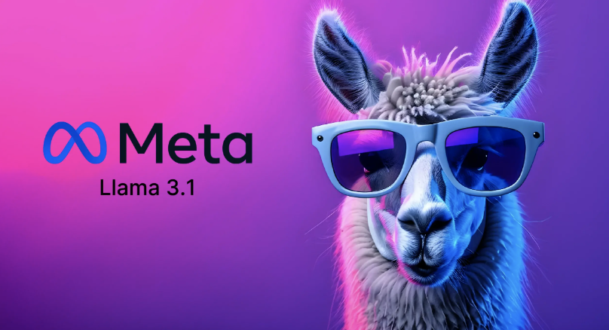
The Llama 3 Herd of Models
AI @ Meta
COMPUTER SCIENCE
GRAINGER ENGINEERING

Slide 6
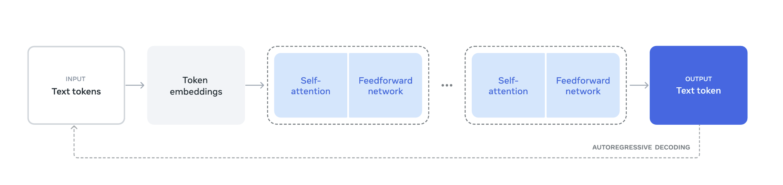
Llama-3 Model Overview
Figure 1 from paper: Illustration of the overall architecture and training of Llama 3.
COMPUTER SCIENCE
GRAINGER ENGINEERING
Notes:
Nishi:
This diagram shows the Llama 3 architecture and training process.
Language model pre-training is the first stage, where the model learns from vast amounts of text by predicting the next token. This involves token embeddings, self-attention layers, and feedforward networks, which are repeated across multiple layers.
Language model post-training refines the pre-trained model using supervised fine-tuning and direct preference optimization (DPO), making it better at following instructions and aligning with human feedback.
Additionally, Llama 3 includes three extra stages:
Multimodal encoder pre-training, adding capabilities like image and speech understanding
Vision adapter training, integrating visual processing
Speech adapter training, enabling the model to understand and generate spoken language

Slide 7
Llama-3 Model Pretraining
Llama-3's dataset includes web data, code, reasoning data, and multilingual content up to the end of 2023
Steps
Data Cleaning & Filtering:
Removed PII harmful content low-quality text
Scaling Laws + Optimization:
Optimized model size and training tokens 405B parameters
Efficient Training:
Used 4D parallelism and 16K H100 GPUs
Long Context + Annealing:
Extended to 128K tokens improved reasoning and math
COMPUTER SCIENCE
GRAINGER ENGINEERING
Notes:
Nishi
Llama-3 was trained on a diverse dataset that includes web data, code, reasoning data, and multilingual content, ensuring a broad knowledge base up to the end of 2023.
To maintain quality and safety, the data was extensively cleaned and filtered, removing personally identifiable information, harmful content, and low-quality text.
Scaling laws were used to determine the optimal model size and data mix, leading to a 405B-parameter model trained on 15.6 trillion tokens—nearly 50× more than Llama 2.
Training was conducted on 16K H100 GPUs, using 4D parallelism to improve efficiency.
Finally, Llama-3 supports longer context lengths, up to 128K tokens, and applied annealing techniques to enhance reasoning and mathematical abilities.

Slide 8
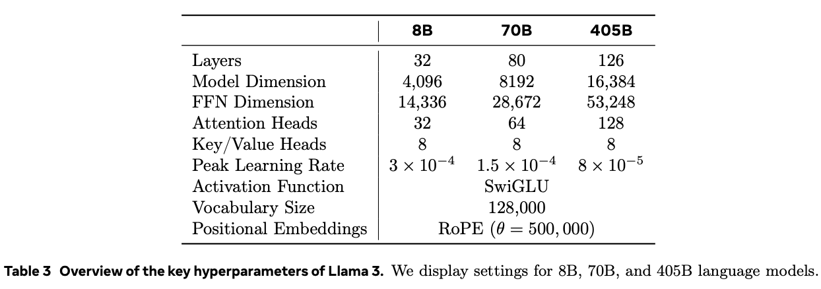
Llama-3 Model Architecture
COMPUTER SCIENCE
GRAINGER ENGINEERING
Notes:
Nishi
Llama 3 405B uses an architecture with 126 layers, a token representation dimension of 16,384, and 128 attention heads This leads to a model size that is approximately compute-optimal according to scaling laws on our data for our training budget of 3.8 × 1025 FLOPs. FLOPs are a measure of computing power.
Llama 3 405B was determined to be compute-optimal using scaling laws, which is basically a relationship that describes how a model's performance improves as its size, dataset, and compute budget increase. Llama 3 balances model size and training tokens within a 3.8 × 10²⁵ FLOPs budget. Meta trained models of varying sizes and used a power-law function to predict the optimal number of parameters and tokens, finding α = 0.53, A = 0.29. This analysis suggested a 402B model trained on 16.55T tokens, leading to their final choice of 405B parameters for robustness.

Slide 9
Llama-3 Model Architecture: Modifications from Llama-2
Feature | Llama-2 | Llama-3
Max Parameters | 70B | 405B
Model Variants | 7B, 13B, 70B | 8B, 70B, 405B
Context Windows | 4K | 128K
Training Tokens | 1.8T | 15.6T
Training Compute | 7.8× 10²³ FLOPS | 3.8 × 10²⁵ FLOPs
Tokenizer | 32K Vocab | 128K Vocab
Parallelism | 3D | 4D
Fine-Tuning | RLHF | DPO
Benchmarks | GPT-3.5 | GPT-4
Multimodal | No | Yes - experimental
Open-Source | Limited | More Permissive
Grouped query attention (GQA)
Attention mask.
128K tokens - 100K tokens from the tiktoken, 28K additional tokens (non-English Languages).
Increases RoPE base frequency hyperparameter - 500,000.
COMPUTER SCIENCE
GRAINGER ENGINEERING
Notes:
Nishi
Llama 3 uses a standard, dense Transformer architecture. It is not that different from Llama and Llama 2 in terms of model architecture;
Their performance gains are mostly due to improvements in data quality and diversity as well as by increased training scale.
Some small modifications from llama-2 are listed here.
They used grouped query attention (GQA) from the paper in 2023, with 8 key-value heads to improve inference speed and to reduce the size of key-value caches during decoding.
[EXTRA - Standard Multi-Head Attention layer (MHA) consists of H query, key and values heads. Each head is of dim D. BUT, GQA uses divides query heads into G groups, each of which shares a single key head and value head.]
They used an attention mask that prevents self-attention between different documents within the same sequence. They found that it didn’t have an impact during in standard pre-training, but found it to be important in pre-training on very long sequences.
Compared to the Llama 2 tokenizer, their new tokenizer improved compression rates on a sample of English data from 3.17 to 3.94 characters per token. This enables the model to “read” more text for the same amount of training compute. They also found that adding 28K tokens from select non-English languages improved both compression ratios and downstream performance, with no impact on English tokenization.

Slide 10
Llama-3 Model Optimization
Key training optimizations:
Cosine learning rate schedule with linear warmup
Weight decay at 0.1× learning rate
Batch sizes increased progressively (from 4M to 16M tokens)
Long-context pre-training (128k tokens):
Incrementally extended context length in six phases
Used 800B training tokens for long-context adaptation
Final Annealing Stage:
Learning rate linearly decayed to 0 over 40M tokens
High-quality data upsampled for final refinements
COMPUTER SCIENCE
GRAINGER ENGINEERING
Notes:
Nishi
Llama 3's training process included several key optimizations to maximize performance and stability. The cosine learning rate schedule gradually decreases the learning rate following a cosine curve, allowing for larger updates at the start and smaller, more refined updates toward the end of training. A cosine learning rate schedule with linear warmup helped smooth convergence, while weight decay at 10% of the learning rate prevented overfitting.The batch size was progressively increased from 4M to 16M tokens to improve efficiency.
For long-context pre-training, the model’s context length was incrementally extended to 128K tokens over six phases, using 800B training tokens to ensure stable adaptation.
Finally, during the annealing stage, which is the stage where the model is fine-tuned on a smaller, high-quality dataset to stabilize training and improve generalization, the learning rate was gradually reduced to zero over 40M tokens, while high-quality data was upsampled to refine reasoning and factual accuracy in the final model.

Slide 11
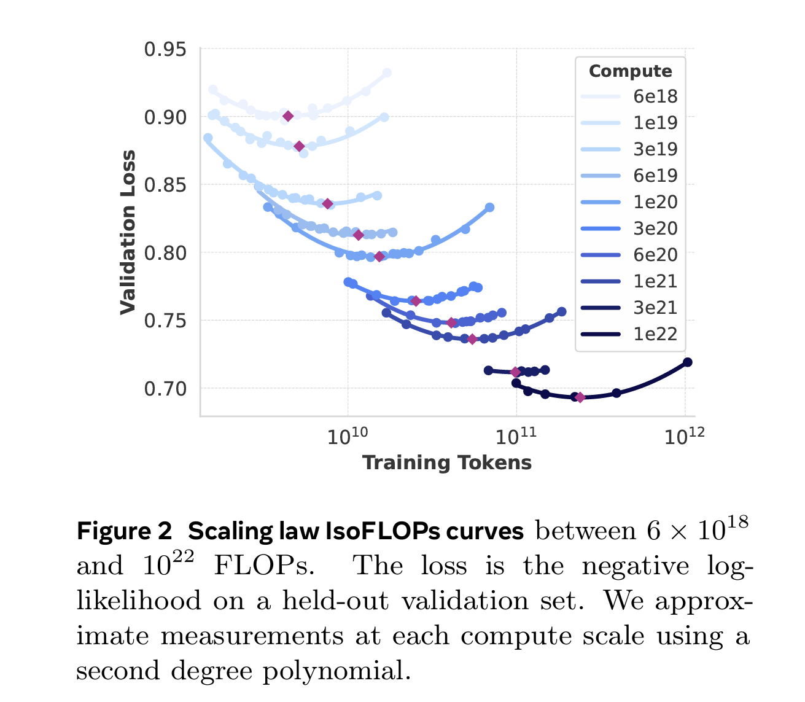
Llama-3 Model Scaling Law Experiments
IsoFLOPs curves help determine the optimal trade-off between model size and training tokens for a given compute budget
The minimum of each parabola in the IsoFLOPs curve corresponds to the compute-optimal model for that budget
COMPUTER SCIENCE
GRAINGER ENGINEERING
Notes:
Nishi
The researchers performed scaling experiments to determine the optimal model size for their model given the pre-training compute budget.
In addition to determining the optimal model size, a major challenge was to forecast the flagship model’s performance on downstream benchmark tasks, due to a couple of issues:
(1) Existing scaling laws typically predict only next-token prediction loss rather than specific benchmark performance.
(2) Scaling laws can be noisy and unreliable because they are developed based on pre-training runs conducted with small compute budgets.
So, we show some of the scaling experiments they performed here in this slide.
These curves are constructed by:
Training models with different parameter sizes (40M to 16B) using varying compute budgets (6 × 10¹⁸ to 10²² FLOPs)
Measuring validation loss for each model at different compute budgets
Fitting a second-degree polynomial to approximate the loss
REST - read off slides.

Slide 12
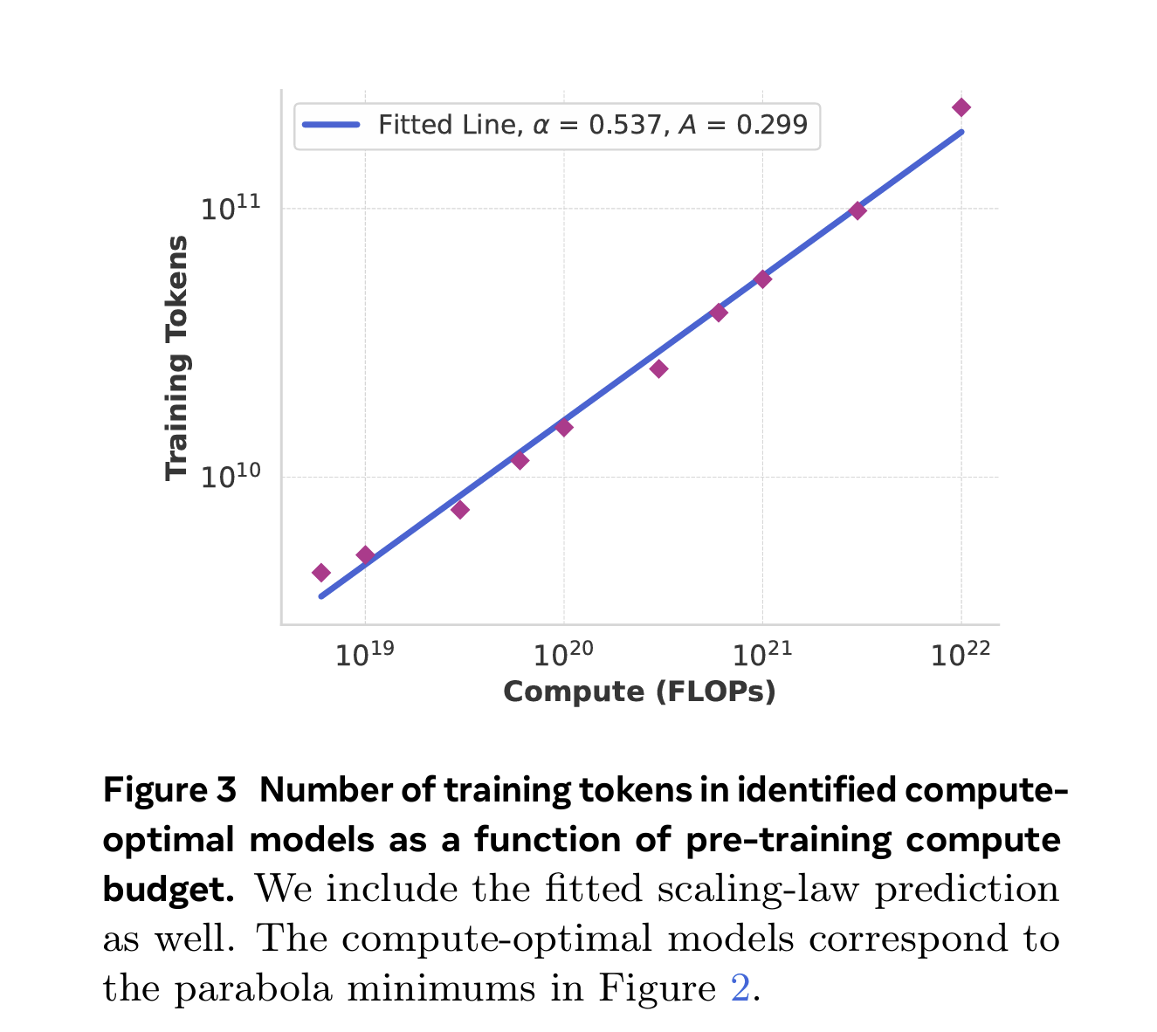
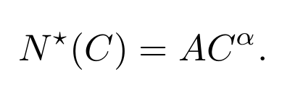
Llama-3 Training Tokens vs. FLOPS
Extrapolation of the resulting scaling law to 3.8 × 10^25 FLOPs suggests training a 402B parameter model on 16.55T tokens.
power-law relation between compute budget, C, and the optimal number of training tokens, N⋆(C)
COMPUTER SCIENCE
GRAINGER ENGINEERING
Notes:
Nishi
We use the compute-optimal models we identified this way to predict the optimal number of training tokens for a specific compute budget.
To do so, we assume a power-law relation between compute budget, C, and the optimal number of training tokens,
N* (C) = AC^α
An important observation is that IsoFLOPs curves become flatter around the minimum as the compute budget increases. This implies that performance of the flagship model is relatively robust to small changes in the trade-off between model size and training tokens. Based on this observation, they ultimately decided to train a flagship model with 405B parameters

Slide 13
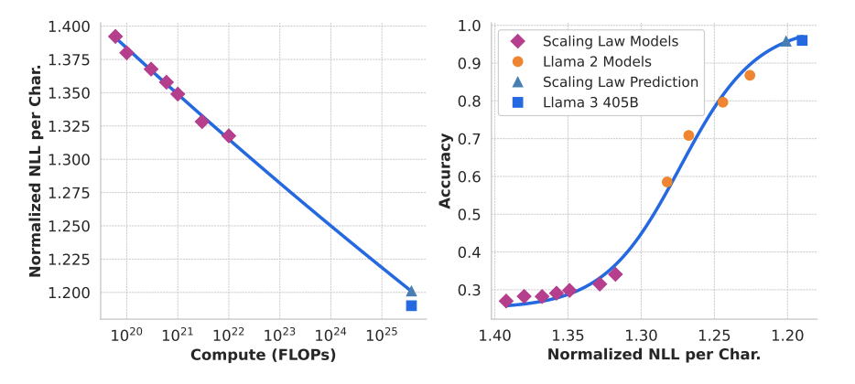
Llama-3 Model Performance on Downstream Tasks
Uses negative log-likelihood (NLL) to correlate training FLOPs with downstream task accuracy, leveraging Llama 2 models
Llama 3 405B follows the predicted scaling trends, demonstrating improved efficiency and performance compared to Llama 2
COMPUTER SCIENCE
GRAINGER ENGINEERING
Notes:
Nishi
NLL is used in language modeling to measure how well a model predicts the next token in a sequence. A lower NLL means the model assigns higher probability to the correct tokens, indicating better language understanding.
In this case, NLL is used to evaluate scaling efficiency—the left graph shows that as compute (FLOPs) increases, NLL decreases, meaning Llama 3 learns more effectively with more training. The right graph links NLL to accuracy on downstream tasks, showing that as NLL drops, task performance improves. Since Llama 3 follows the predicted trend and outperforms Llama 2 at the same NLL, this confirms that its training optimizations led to better generalization and efficiency rather than just relying on a larger model size.

Slide 14
Llama-3 Infrastructure: Compute & Storage
Compute
Llama 3 405B is trained on up to 16K H100 GPUs.
Running at 700W TDP with 80GB HBM3, using Meta’s Grand Teton AI server platform.
Storage
Uses Tectonic - Meta’s general-purpose distributed file system for Llama 3 pre-training.
Offers 240 PB of storage out of 7,500 servers equipped with SSDs
COMPUTER SCIENCE
GRAINGER ENGINEERING
Notes:
Akhil COMPUTE
Each server is equipped with eight GPUs and two CPUs.
The eight GPUs are connected via NVLink.
Training jobs are scheduled using MAST (Meta’s global-scale training scheduler.)
STORAGE
Tectonic supports a sustainable throughput of 2 TB/s and a peak throughput of 7 TB/s.
A major challenge is supporting the highly bursty checkpoint writes that saturate the storage fabric for short durations.
Checkpointing saves each GPU’s model state, ranging from 1 MB to 4 GB per GPU, for recovery and debugging.

Slide 15
Llama-3 Infrastructure: Network
Topology
24K GPUs connected by a three-layer Clos network.
Three layers - Bottom (16 GPUS) Middle layer Pod (192 Bottom layer racks), Top (8 Middle layer pods)
Load Balancing
Network flows that are hard to load balance across all available network paths using traditional methods.
Enhanced-ECMP (E-ECMP) protocol.
Compute Congestion Control
Deep-buffer switches helps limit the impact of persistent congestion and network back pressure caused by slow servers.
COMPUTER SCIENCE
GRAINGER ENGINEERING
Notes:
Akhil Llama 3 405B used RDMA over Converged Ethernet (RoCE) fabric based on the Arista 7800 and Minipack2 Open Compute rack switches.
Only up to 16K of these 24K GPUs for Llama 3 pre-training.
At the bottom layer, each rack hosts 16 GPUs split between two servers and connected by a single Minipack2 top-of-the-rack (ToR) switch.
In the middle layer, 192 such racks are connected by Cluster Switches to form a pod of 3,072 GPUs with full bisection bandwidth, ensuring no oversubscription.
At the top layer, eight such pods within the same datacenter building are connected via Aggregation Switches to form a cluster of 24K GPUs.
Our model parallelism methods and training job scheduler are aware of network topology.
LB:
First, our collective library creates 16 network flows between two GPUs, instead of just one, thereby reducing the traffic per flow and providing more flows for load balancing. Second, our Enhanced-ECMP (E-ECMP) protocol effectively balances these 16 flows across different network paths by hashing on additional fields in the RoCE header of packets.
CONGESTION
Better load balancing through E-ECMP significantly reduces the chance of congestion.

Slide 16
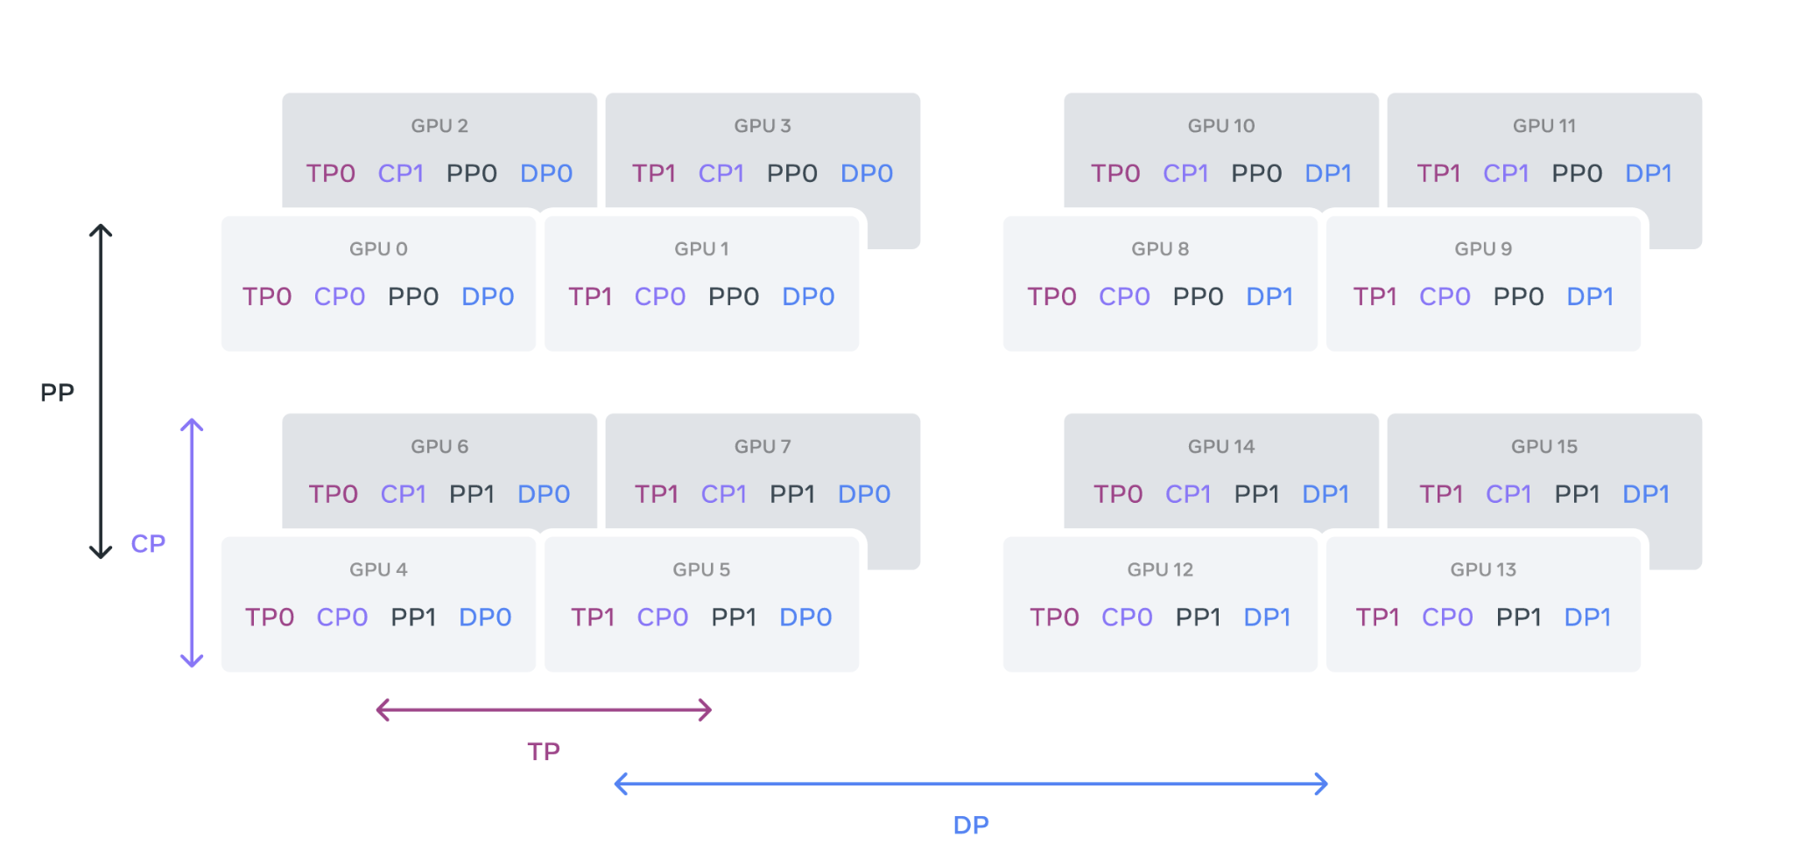
Llama-3 Infrastructure: Model Scaling
4D Scaling
Tensor Parallelism
Pipeline Parallelism
Context Parallelism
Data Parallelism
COMPUTER SCIENCE
GRAINGER ENGINEERING
Notes:
Akhil Use 4 different types of parallelism to scale the model
Tensor parallelism splits individual weight tensors into multiple chunks on different devices.
Pipeline parallelism partitions the model vertically into stages by layers, so that different devices can process in parallel different stages of the full model pipeline.
Context parallelism divides the input context into segments, reducing memory bottleneck for very long sequence length inputs.
They use fully sharded data parallelism, which shards the model, optimizer, and gradients while implementing data parallelism which processes data in parallel on multiple GPUs and synchronizes after each training step.

Slide 17
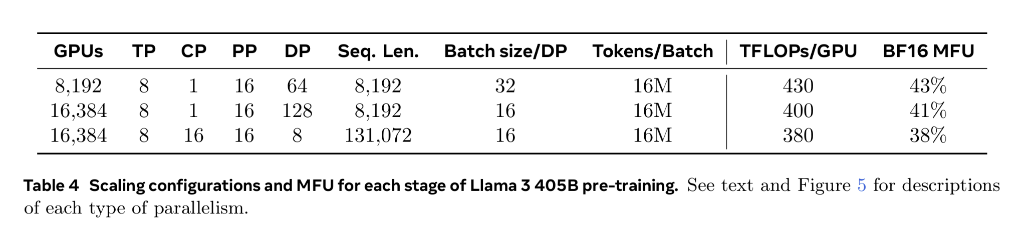
Llama-3 Infrastructure: Model Scaling
GPU Utilization
Achieved an overall BF16 Model FLOPs Utilization of 38-43%
Slight drop in MFU to 41% on 16K GPUs with DP=128 compared to 43% on 8K GPUs with DP=64
COMPUTER SCIENCE
GRAINGER ENGINEERING
Notes:
Akhil After fine-tuning hardware, model and parallelism, they achieved FLOPs Utilization of 38-43% for the configs shown in the table.
There is a drop is from 43% to 41% from Data Parallelism 64 to 128.
This is due to the lower batch size per DP group needed to keep the global tokens per batch constant during training.

Slide 18
Llama-3 Infrastructure: Parallelism Challenges
Batch size constraint.
Constraints on supported batch size per GPU
Memory Imbalance
Imbalanced resource consumption.
Computation Imbalance.
Execution Stage bottleneck
COMPUTER SCIENCE
GRAINGER ENGINEERING
Notes:
Akhil Batch Size - requires it to be divisible by the number of pipeline stages. However, they found that pre-training often needs flexibility to adjust batch size.
Existing pipeline parallelism implementations lead to imbalanced resource consumption.
Memory Imbalance - The first stage consumes more memory due to the embedding and the warm-up micro-batches.
Memory Imbalance - After the last layer of the model, we need to calculate output and loss, making this stage the execution latency bottleneck.

Slide 19
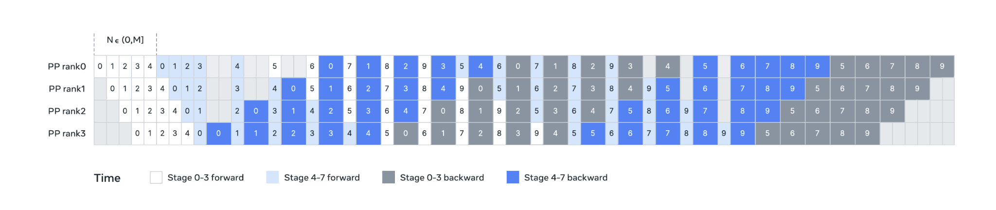
Llama-3 Infrastructure: Parallelism Challenges
COMPUTER SCIENCE
GRAINGER ENGINEERING
Notes:
Akhil To address these issues, they modified their pipeline schedule as shown which allows setting N flexibly. Can run a arbitrary number of micro-batches in each batch. In this case, N= 5
They can run fewer micro-batches than the number of stages when we have batch size limit at large scale; OR They can run more micro-batches to hide point-to-point communication.
We can find the the best communication and memory efficiency by finding a sweetspot in between.
To reduce memory cost, based on detailed memory allocation profiling, they proactively deallocate tensors that will not be used for future computation, including the input and output tensors of each pipeline stage, that will not be used for future computation.

Slide 20
Llama-3 Infrastructure: Parallelism Challenges
Network Aware Parallelism
4D parallelism ordered
Innermost - highest network bandwidth and lowest latency.
Outermost - multi-hop network, tolerates higher network latency
[TP, CP, PP, DP]
COMPUTER SCIENCE
GRAINGER ENGINEERING
Notes:
Akhil We place parallelism dimensions in the order of [TP, CP, PP, DP].
DP (i.e., FSDP) is the outermost parallelism because it can tolerate longer network latency by asynchronously prefetching sharded model weights and reducing gradients.
Developed a memory consumption estimator and a performance-projection tool which helped us explore various parallelism configurations.
Llama 3 is based on a fork of Nvidia’s NCCL library, called NCCLX.
The original NCCL collectives required data chunking and staged data copy. This approach had several inefficiencies, including
(1) requiring a large number of small control messages to be exchanged over the network to facilitate data transfer, (2) extra memory-copy operations, and (3) using extra GPU cycles for communication.
In Llama-3, they tune chunking and data transfer to fit network latencies. They allow small control messages to traverse our network at a higher priority. The paper mentions that this is something they are working to improve in their research.

Slide 21
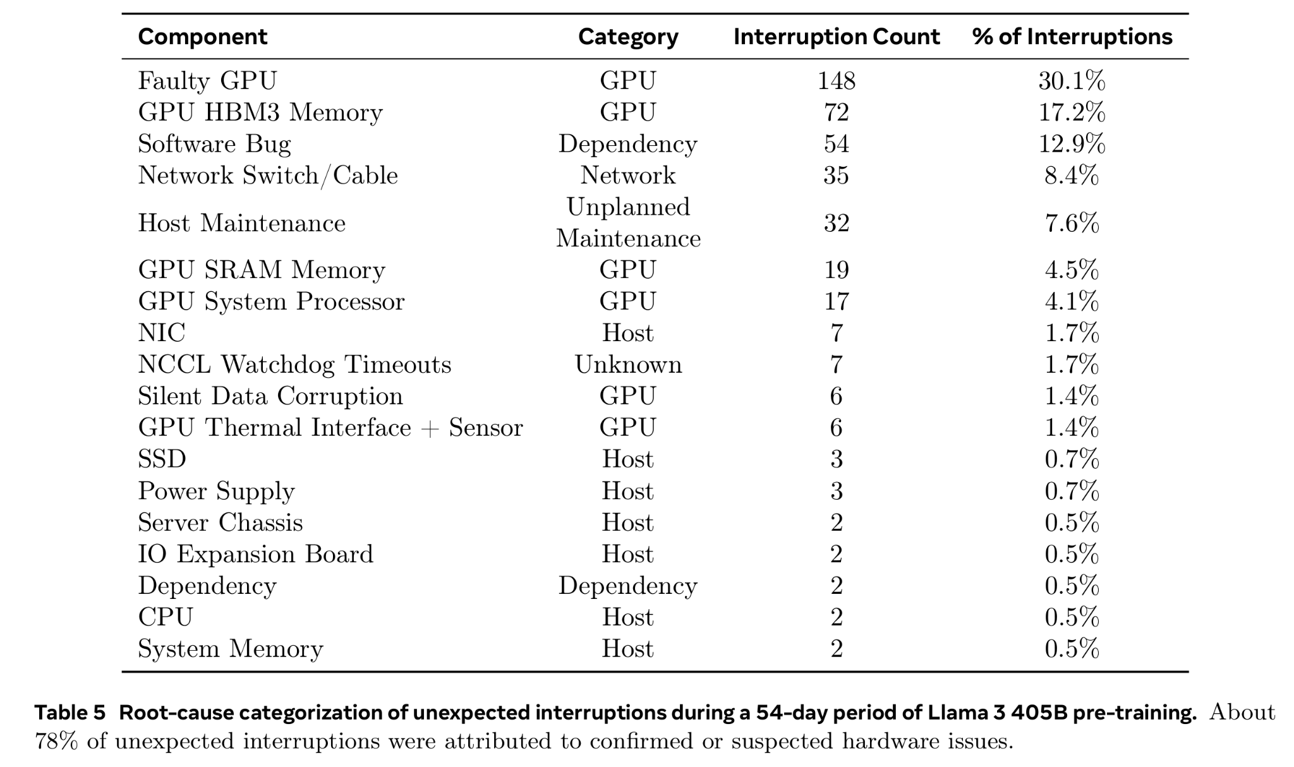
Llama-3 Infrastructure: Operation Inefficiencies
COMPUTER SCIENCE
GRAINGER ENGINEERING
Notes:
Akhil The synchronous nature of training makes it less fault-tolerant—a single GPU failure may require a restart of the entire job.
During a 54-day snapshot period of pre-training, they experienced a total of 466 job interruptions.
Of these, 47 were planned interruptions due to automated maintenance operations, such as firmware upgrades, or operator-initiated operations like configuration or dataset updates.
The remaining 419 were unexpected interruptions, which are classified in Table 5.
Approximately 78% of the unexpected interruptions are attributed to confirmed hardware issues, such as GPU or host component failures, or suspected hardware-related issues like silent data corruption and unplanned individual host maintenance events.
GPU issues are the largest category, accounting for 58.7% of all unexpected issues.
Despite the large number of failures, significant manual intervention was required only three times during this period, with the rest of the issues handled by automation.
To fix this, they
Reduced job startup and checkpointing time,
Developed tools for fast diagnosis and problem resolution.

Slide 22
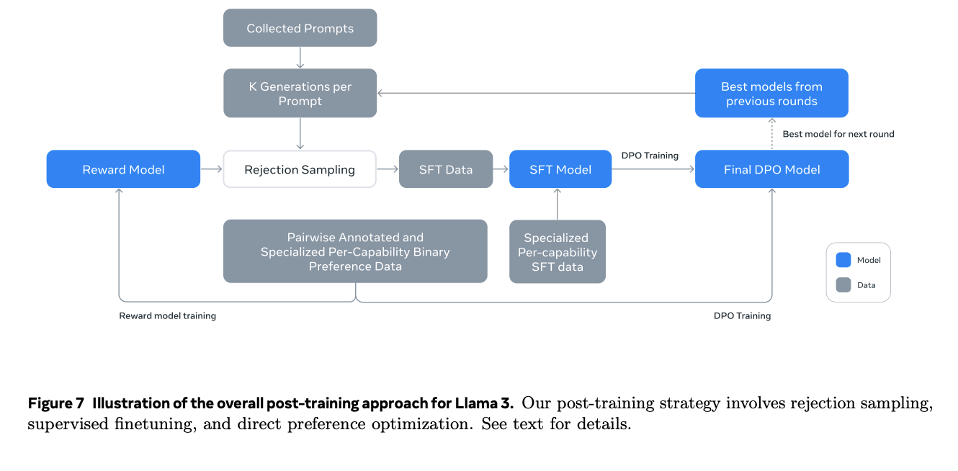
Llama Post-training
Supervised Finetuning (SFT)
Direct Preference Optimization (DPO)
Reward Modeling
Iterative Rounds & Model Averaging
COMPUTER SCIENCE
GRAINGER ENGINEERING
Notes:
Akhil
Found that post-training had an outsized impact on model performance.
Supervised Finetuning (SFT)
Uses human-annotated and synthetic examples
Optimizes with standard cross-entropy loss
Improves instruction-following and factual accuracy
Direct Preference Optimization (DPO)
Aligns model responses to human preferences
Uses preference-ranked examples for fine-tuning
Enhances helpfulness, safety, and response quality
Reward Modeling
Trains a model to rank response quality
Enables rejection sampling for better outputs
Reduces hallucinations and biases
Iterative Rounds & Model Averaging
Conducts multiple refinement cycles
Uses the best models from each round for final merging
Stabilizes performance across diverse tasks

Slide 23
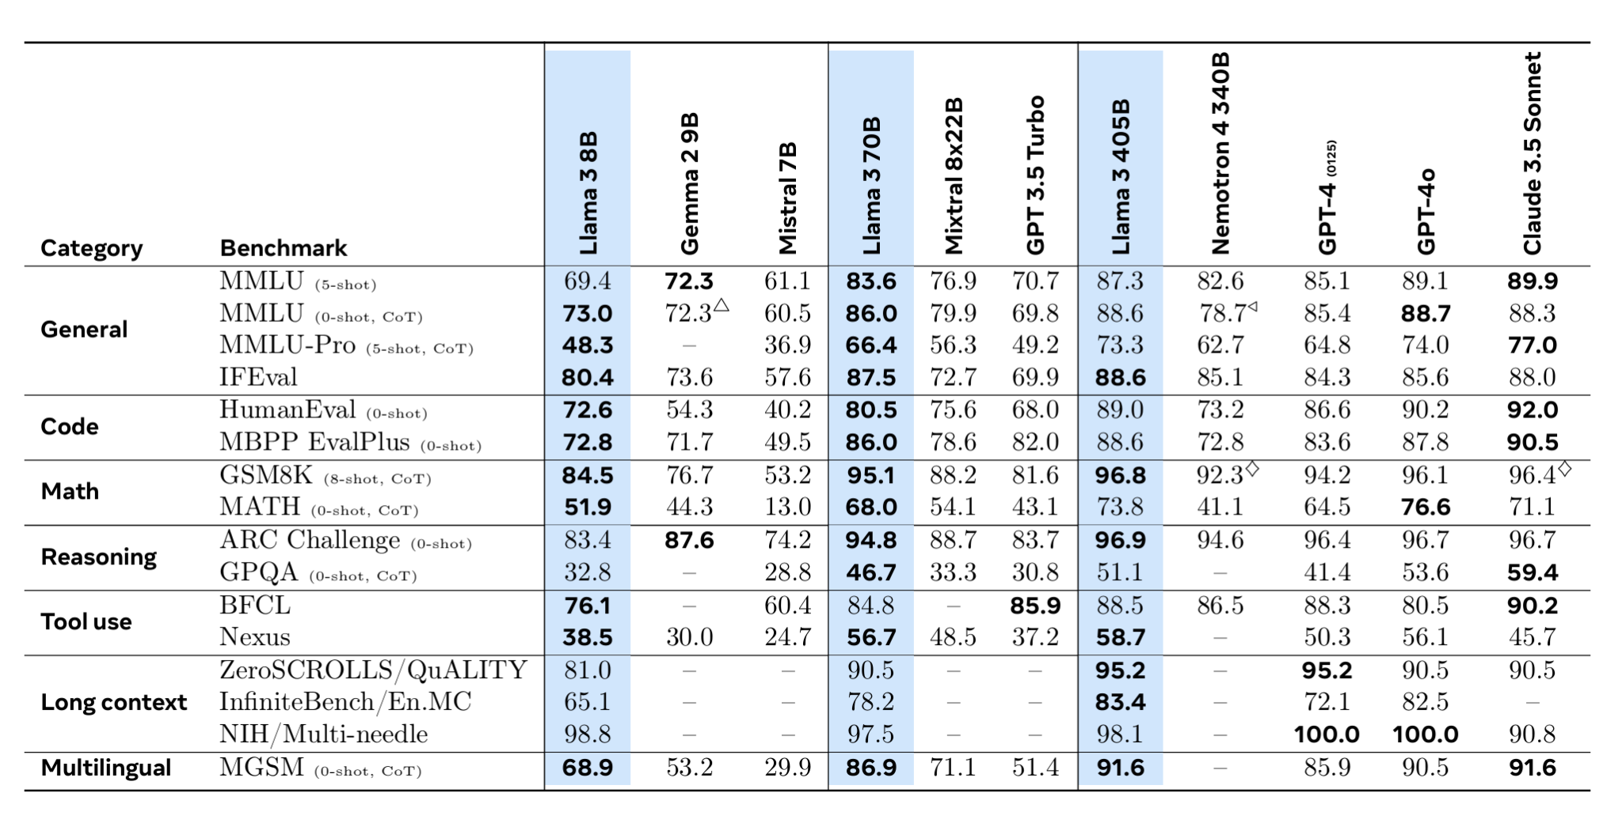
Performance on Key Benchmarks
COMPUTER SCIENCE
GRAINGER ENGINEERING
Notes:
Akhil This table show Llama 3's performance across benchmarks compared to other models like GPT-4, Claude 3.5 Sonnet, and Mixtral. The categories include general knowledge (MMLU, IFEval), coding (HumanEval, MBPP), math (GSM8K, MATH), reasoning (ARC, GPQA), tool use, long-context understanding, and multilingual capabilities.
Llama 3 405B performs strongly, often outperforming GPT-3.5 Turbo and competing closely with GPT-4-level models. Notably:
General benchmarks: Llama 3 405B scores 88.6 on MMLU (0-shot, CoT), on par with GPT-4 and ahead of Mixtral (69.8).
Coding: 89.0 on HumanEval, competitive with GPT-4 (90.2) but trailing Claude 3.5 Sonnet (92.0).
Math: 96.8 on GSM8K, the highest among models, showing superior mathematical reasoning.
Long-context: Excels with 95.2 on ZeroSCROLLS/QuALITY, demonstrating strong context retention.
Multilingual: 91.6 on MGSM, indicating strong performance in non-English tasks.
Overall, Llama 3 405B shows state-of-the-art performance in math, long-context, and multilingual tasks, making it one of the most competitive open models.

Slide 24
Drawbacks of Llama-3
High Computational + Energy Costs
Training the 405B model required 16K H100 GPUs and an enormous compute budget (3.8 × 10²⁵ FLOPs).
Large-scale training contributes to high power consumption.
Scaling Complexity and Reliability Issues
Running such a massive model introduces frequent hardware failures, with GPU failures alone accounting for ~59% of unexpected training interruptions.
Network congestion, synchronization challenges, and inefficient load balancing across GPUs slow down training and inference.
Nvidia’s NCCL library, called NCCLX require more changes to reduce inefficiencies in communication.
Long-Context Processing Limitations
Scaling up context length quadratically increases compute costs
COMPUTER SCIENCE
GRAINGER ENGINEERING
Notes:
Akhil
Not exactly drawbacks, but some points on what can be worked on.
POWER/ COST: It’s always a large cost, and with any foundational model, improving power consumption is something to focus on.
RELIABILITY: They faced operational issues with a model of this scale. As we saw earlier, a big part of the operational interruptions were due to unexpected GPU failures.
NETWORK: They improved Nvidia’s NCCL library, but as they mention in the paper, it is not completely optimised to their network topology.

Slide 25
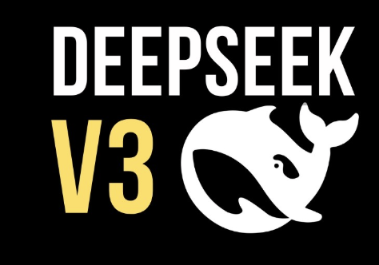

DeepSeek-v3
DeepSeek-AI Team
COMPUTER SCIENCE
GRAINGER ENGINEERING

Slide 26
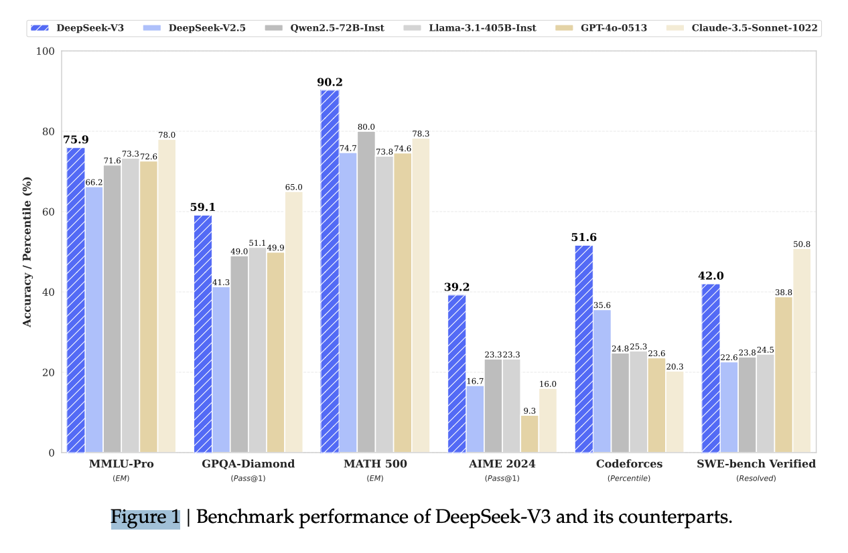
Introduction
A state-of-the-art open-source Mixture-of-Experts (MoE) language model. Operates with 671B total parameters, with 37B activated per token.
Multi-head Latent Attention (MLA) for efficient inference.
Auxiliary-loss-free load balancing to enhance performance.
Multi-token prediction (MTP) objective for improved training efficiency. Training Efficiency
Pre-trained on 14.8T tokens using FP8 mixed precision.
Requires only 2.788M GPU hours, making it cost-effective.
Deployment Vision
Designed for scalable and efficient training and inference.
Aims to bridge the gap between open-source and closed-source AI models.
COMPUTER SCIENCE
GRAINGER ENGINEERING
Notes:
So, let's talk about DeepSeek-v3 – an advanced Mixture-of-Experts (MoE) language model.
It’s massive! – 671B total parameters, but only 37B are activated per token, which makes it much more efficient.
One of the key innovations here is Multi-head Latent Attention (MLA), which helps with faster inference.
Unlike traditional MoE models, DeepSeek uses an auxiliary-loss-free load-balancing mechanism to enhance performance.
Training efficiency is a big focus – it’s pre-trained on 14.8T tokens using FP8 mixed precision, which keeps costs lower.
Despite its scale, it only took 2.788M GPU hours, making it one of the most cost-effective large-scale MoE models out there.
Finally, the goal of DeepSeek is to bridge the gap between open-source and closed-source models, making powerful AI more accessible.

Slide 27
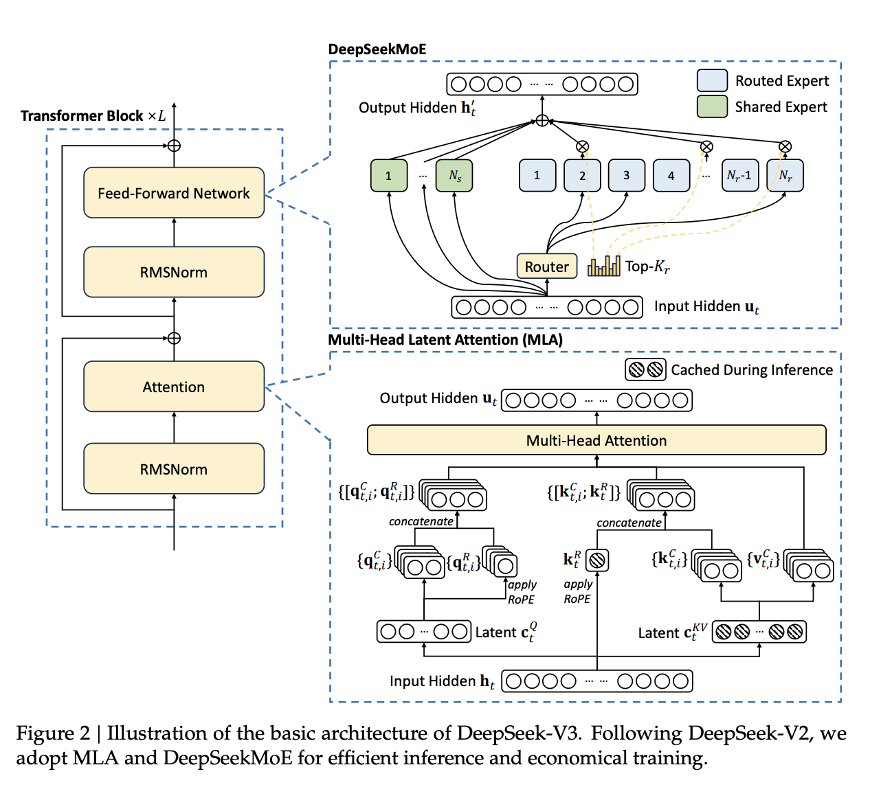
Architecture
COMPUTER SCIENCE
GRAINGER ENGINEERING
Notes:
DeepSeek's training is handled by an infrastructure of 2048 NVIDIA H800 GPUs, which is huge.
Each node contains 8 GPUs, all connected via NVLink and NVSwitch for high-speed communication.
Inter-node communication is managed using InfiniBand (IB) interconnects, which is crucial for scaling efficiently.
Bandwidth is optimized – NVLink offers 160GB/s for intra-node transfers, while InfiniBand provides 50GB/s across nodes.
One of the biggest challenges in MoE models is communication overhead, but DeepSeek cleverly overlaps computation and communication to hide latency.
This is done using a strategy called DualPipe – ensuring that GPUs are always busy with either computation or data transfer.
This setup allows DeepSeek to scale efficiently, even with complex MoE architectures.

Slide 28
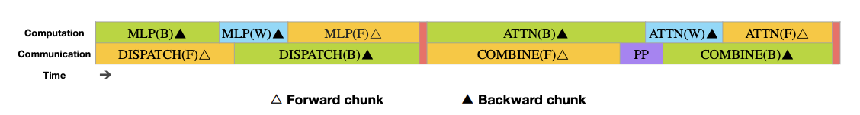
Infrastructures
Compute Clusters
Overview:
DeepSeek-V3 trained on a cluster of 2048 NVIDIA H800 GPUs.
Each node contains 8 GPUs interconnected via NVLink and NVSwitch.
Inter-node communication handled by InfiniBand (IB) interconnects.
Pivotal Features:
High bandwidth within nodes: NVLink at 160 GB/s.
Cross-node communication via IB at 50 GB/s.
Optimized overlapping strategies to hide communication latency during computation.
Overlapping strategy in the DualPipe algorithm for pipeline parallelism. It illustrates how forward and backward computations (orange, green, and blue) are interleaved with pipeline communication (purple) and barriers (red), ensuring that both all-to-all and pipeline-parallel communication are fully hidden during execution. This overlap minimizes idle time and improves training efficiency.
COMPUTER SCIENCE
GRAINGER ENGINEERING
Notes:
Slide 29: DeepSeek - Training Framework
DeepSeek uses the HAI-LLM framework, which is optimized for large-scale MoE training.
It combines multiple parallelism techniques – 16-way Pipeline Parallelism (PP), 64-way Expert Parallelism (EP), and ZeRO-1 Data Parallelism (DP).
Each of these serves a purpose – Pipeline Parallelism distributes layers across GPUs, Expert Parallelism spreads MoE layers across nodes, and Data Parallelism manages memory efficiently.
A key innovation here is the DualPipe Algorithm, which cleverly overlaps computation and communication.
Instead of waiting for data to be transferred, the GPUs continue processing to avoid idle time.
Another optimization is the use of custom all-to-all communication kernels, which are designed specifically for DeepSeek's MoE architecture.
These techniques allow DeepSeek to scale efficiently, keeping performance high while managing huge model sizes.

Slide 29
Infrastructures
Training Framework Overview
Framework Used: HAI-LLM Framework.
Parallelism Techniques:
16-way Pipeline Parallelism (PP) for distributing layers across GPUs.
64-way Expert Parallelism (EP) for MoE layers across nodes.
ZeRO-1 Data Parallelism (DP) for memory efficiency.
Key Innovations:
DualPipe Algorithm:Overlaps computation and communication phases.
Efficient cross-node all-to-all communication kernels leveraging IB and NVLink bandwidths.
COMPUTER SCIENCE
GRAINGER ENGINEERING
Notes:
Slide 30: DeepSeek - Efficient Cross-Node Communication
One of the biggest bottlenecks in MoE models is cross-node communication.
DeepSeek tackles this problem by using customized all-to-all kernels, which work in sync with MoE gating.
Instead of overloading InfiniBand with massive data transfers, tokens are routed efficiently to at most 4 nodes.
Within each node, NVLink handles the bulk of communication, keeping bandwidth utilization high.
InfiniBand is still used for inter-node transfers, but its load is reduced by overlapping it with NVLink operations.
Optimization techniques like warp specialization ensure that GPU processing power is not wasted on communication tasks.
As a result, DeepSeek reduces interconnect bottlenecks, which is a huge win for scaling MoE models.

Slide 30
Infrastructures
Efficient Cross-Node Communication
Implementation Details
Customized all-to-all kernels co-designed with MoE gating and network topology.
Tokens routed to at most 4 nodes, reducing IB traffic.
Bandwidth Utilization
NVLink bandwidth fully leveraged for intra-node communication.
IB handles inter-node transfers efficiently with overlap between IB and NVLink operations.
Optimization Techniques
Warp specialization conserves GPU SMs for communication tasks.
Auto-tuned chunk sizes minimize L2 cache interference.
COMPUTER SCIENCE
GRAINGER ENGINEERING
Notes:
Slide 31: DeepSeek - DualPipe Algorithm
DeepSeek's biggest breakthrough in efficiency comes from the DualPipe Algorithm.
Why was this needed? – MoE models have a high communication-to-computation ratio, making them inefficient.
DualPipe solves this by overlapping computation with communication – so that neither step slows the model down.
It does this by scheduling forward and backward passes in a bidirectional pipeline, ensuring that GPUs are never idle.
The key benefit? – Almost zero overhead for all-to-all communication, which is a major improvement.
This also reduces memory usage while keeping training stable and efficient.
With DualPipe, DeepSeek achieves incredible scalability, making it viable for even larger MoE models in the future.

Slide 31
Infrastructures
DualPipe Algorithm
Problem Addressed
High communication overhead in cross-node expert parallelism (~1:1 computation-to-communication ratio).
Solution
DualPipe overlaps forward/backward computation with communication phases.
Bidirectional pipeline scheduling minimizes idle time.
Benefits
Achieves near-zero all-to-all communication overhead as model scales.
Reduces pipeline bubbles while maintaining memory efficiency.
COMPUTER SCIENCE
GRAINGER ENGINEERING
Notes:
DeepSeek's biggest breakthrough in efficiency comes from the DualPipe Algorithm.
Why was this needed? – MoE models have a high communication-to-computation ratio, making them inefficient.
DualPipe solves this by overlapping computation with communication – so that neither step slows the model down.
It does this by scheduling forward and backward passes in a bidirectional pipeline, ensuring that GPUs are never idle.
The key benefit? – Almost zero overhead for all-to-all communication, which is a major improvement.
This also reduces memory usage while keeping training stable and efficient.
With DualPipe, DeepSeek achieves incredible scalability, making it viable for even larger MoE models in the future.

Slide 32
Infrastructures
Extremely Memory Saving with Minimal Overhead
Recomputing RMSNorm & MLA Up-Projection: Avoids storing outputs, saving memory with minimal compute cost.
EMA on CPU: Keeps EMA parameters in CPU memory, updating asynchronously to cut GPU usage without delays.
Shared Embedding & Output Head for MTP: Uses same PP rank for shallow & deep layers, enabling parameter sharing.
Impact: Reduces GPU memory while maintaining stability, enabling large-scale training without costly tensor parallelism.
COMPUTER SCIENCE
GRAINGER ENGINEERING
Notes:
Memory efficiency is critical for training such a massive model.
DeepSeek saves memory in multiple ways, such as recomputing RMSNorm & MLA Up-Projection instead of storing outputs.
It also moves Exponential Moving Average (EMA) calculations to CPU memory, freeing up GPU resources.
Another optimization is shared embedding and output heads for Multi-Token Prediction (MTP), which cuts down redundant parameters.
By implementing these techniques, DeepSeek significantly reduces GPU memory usage.
This allows DeepSeek to scale without needing tensor parallelism, keeping the training process simpler and more stable.
The bottom line? – DeepSeek trains efficiently while keeping memory costs as low as possible.

Slide 33
Inference and Deployment
Overview
Deployment Strategy
Prefilling and decoding stages separated for efficiency.
Minimum deployment unit:
Prefilling: 4 nodes, with 32 GPUs.
Decoding: 40 nodes, with 320 GPUs.
Key Features
Prefilling uses redundant experts for load balancing across GPUs.
Decoding employs direct point-to-point transfers over IB for low latency.
COMPUTER SCIENCE
GRAINGER ENGINEERING
Notes:
DeepSeek separates prefilling and decoding stages, optimizing efficiency at both training and inference.
Prefilling happens in smaller units – 4 nodes, with 32 GPUs each, to balance computational load.
Decoding, however, scales up significantly, using 40 nodes with 320 GPUs for rapid response generation.
Prefilling utilizes redundant experts, ensuring that no GPU sits idle during the process.
Decoding optimizes network traffic using direct point-to-point InfiniBand transfers.
This deployment strategy is crucial for handling large-scale inference workloads, keeping latency as low as possible.
By designing inference with efficiency in mind, DeepSeek ensures that real-world applications can scale smoothly.
This slide discusses the final aspects of training and how they plan to deploy DeepSeek.
They separate “prefilling” (initial context reading) from “decoding” (generating new tokens) across different sets of nodes.
Prefilling: 4 nodes, each with 32 GPUs, possibly for short bursts of heavy context ingestion.
Decoding: 40 nodes, each with 320 GPUs, for parallel token generation in real-time.
Redundancy is used to handle load spikes and keep latencies low during inference.
A big advantage is that they can scale the decoding nodes horizontally based on application needs.

Slide 34
Inference and Deployment
Prefilling stage
Configuration
Attention layers use TP4 with Sequence Parallelism (SP).
MoE layers use EP32 to ensure large batch sizes per expert.
Load Balancing Strategy
Redundant experts deployed dynamically based on real-time load statistics.
Optimization Techniques
Overlapping micro-batches hides all-to-all and TP communication overheads.
COMPUTER SCIENCE
GRAINGER ENGINEERING
Notes:
Inference in DeepSeek is broken into two main stages – prefilling and decoding.
During the prefilling stage, attention layers use TP4 with Sequence Parallelism (SP) to ensure smooth operations.
MoE layers use Expert Parallelism (EP32), ensuring that batch sizes remain large while keeping load balanced.
A key innovation here is dynamic redundancy, where redundant experts are deployed based on real-time load statistics.
Micro-batches are overlapped, meaning computation continues while communication happens in the background.
This slide focuses on how the “prefilling” stage is set up:
Attention layers using TP4 with Sequence Parallelism (SP).
MoE layers on EP32 to handle large batch sizes per expert.
Redundant experts deployed dynamically—meaning if one set is busy, another can step in.
They also overlap micro-batches to mask communication costs.
By the time the model finishes this stage, the initial context is loaded and processed, prepping for smooth decoding.

Slide 35
Inference and Deployment
Decoding Stage
Configuration
Attention layers use TP4 with SP; MoE layers use EP32.
Performance Enhancements
Shared experts treated as routed ones to optimize load balancing during routing.
Future Exploration
Dynamic redundancy strategies to further optimize expert deployment and routing schemes.
COMPUTER SCIENCE
GRAINGER ENGINEERING
Notes:
Now the “decoding” stage:
Uses TP4 + SP, while MoE is at EP320—bigger concurrency for generation.
They treat shared experts as routed experts, making sure the gating logic remains consistent.
This method aims to keep all GPUs busy during high-volume text generation.
Future strategies include more dynamic redundancy if some experts become overloaded.
Essentially, it’s a fine-tuned approach to handle real-world inference loads efficiently.

Slide 36
Deepseek Summary
Massive but Efficient: Uses a Mixture-of-Experts design with 671B total parameters, yet only 37B are activated per token .
Enhanced Inference: Employs Multi-head Latent Attention (MLA) to speed up predictions and reduce complexity .
Cost-Effective Training: Pre-trained on 14.8T tokens with FP8 mixed precision, requiring just 2.788M GPU hours .
Specialized Parallelism: Combines 16-way Pipeline Parallelism, 64-way Expert Parallelism, and ZeRO-1 Data Parallelism for memory efficiency .
Overlap to Save Time: The DualPipe algorithm hides communication overhead by interleaving forward/backward passes with all-to-all transfers
COMPUTER SCIENCE
GRAINGER ENGINEERING
Notes:
DeepSeek is a groundbreaking MoE model, striking a balance between scale and efficiency.
Its key strength is its MoE design, where only 37B out of 671B parameters are used at a time, reducing compute costs.
It employs innovative training techniques, including Multi-head Latent Attention (MLA) and DualPipe Algorithm, to optimize performance.
It uses a mix of Pipeline Parallelism, Expert Parallelism, and Data Parallelism for efficient training and inference.
FP8 mixed precision training keeps compute requirements low while maintaining high accuracy.
Cross-node communication is optimized with custom all-to-all kernels, reducing network bottlenecks.
Ultimately, DeepSeek is designed to make massive-scale AI models more accessible and cost-effective, bridging the gap between open-source and proprietary AI.

Slide 37
Takeaways
TL;DR
COMPUTER SCIENCE
GRAINGER ENGINEERING

Slide 38


Deepseek vs. Llama-3
Deepseek
DeepSeek uses a Mixture-of-Experts (MoE) architecture with 671B total parameters but only 37B activated per token
DeepSeek uses a customized 16-way Pipeline Parallelism (PP) and 64-way Expert Parallelism (EP) to efficiently manage MoE layers. It also leverages ZeRO-1 Data Parallelism for better memory efficiency
DeepSeek uses FP8 mixed precision. Additionally, it uses Exponential Moving Average (EMA) on CPU and shared embedding layers for memory savings
Llama-3
Llama-3 uses a dense Transformer model, meaning all parameters are activated for every token processed
Llama-3 employs 4D parallelism (Tensor, Pipeline, Context, and Data Parallelism) to distribute model training across 16K H100 GPUs
Llama-3 trains using BF16 precision and progressively increases batch sizes up to 16M tokens
COMPUTER SCIENCE
GRAINGER ENGINEERING
Notes:
Nishi
DeepSeek uses a Mixture-of-Experts (MoE) architecture, meaning it has 671B total parameters, but only 37B are active per token, improving efficiency. It relies on a complex parallelism strategy with 16-way Pipeline Parallelism (PP), 64-way Expert Parallelism (EP), and ZeRO-1 Data Parallelism, all aimed at managing memory and computational efficiency. It also leverages FP8 mixed precision and Exponential Moving Average (EMA) for memory savings.
Llama-3, in contrast, uses a dense Transformer model, where all parameters are active per token. It employs a 4D parallelism strategy—combining Tensor, Pipeline, Context, and Data Parallelism—to efficiently scale training across 16K H100 GPUs. Instead of FP8, it uses BF16 mixed precision and progressively increases batch sizes up to 16M tokens for improved training stability and efficiency.

Slide 39


Thank You! Special thanks to MOE group for the slides format :)
We open the floor for questions, comments, and discussion.
Llama-generated Valentine’s Day Picture
COMPUTER SCIENCE
GRAINGER ENGINEERING

